Slide 1
MARBEL – Designing an agent system
Multi-Agent Systems
Practical 6

Slide 2
Learning objectives
Gain a hands-on practical experience with how to design a simple version of an agent program for the single agent Vacuum World:
Setting up a mas file.
Agent structure, knowledge and modules.
Agent strategy design.

Slide 3
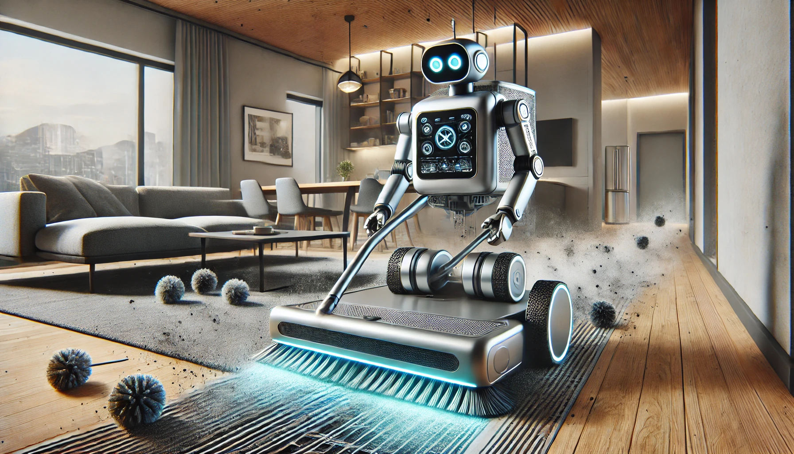
AGENT DESIGN
Recap of main agent design steps.

Slide 4
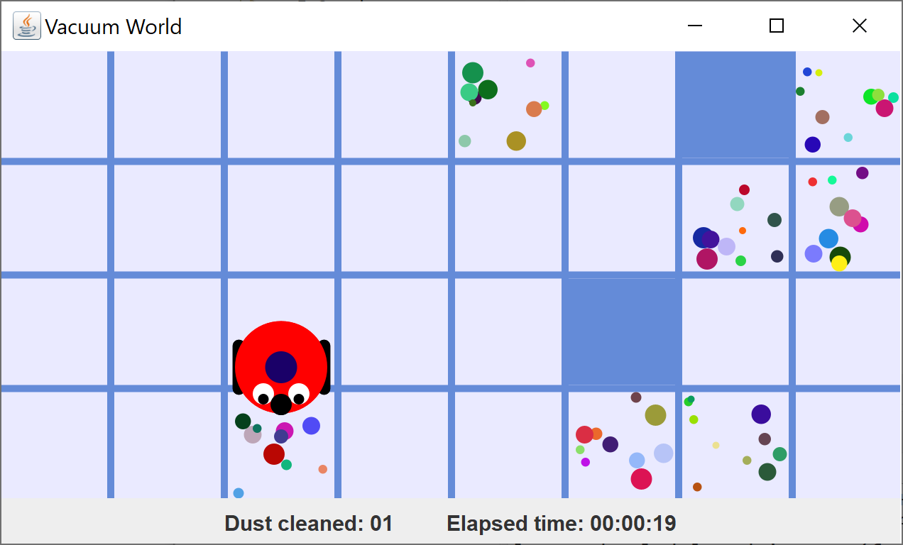
The Vacuum World
Obstacle
VacBot
here
right
left
Dust; we’ll assume it will not re-generate
forward
right
forward
left
forward
Field of vision
Grid has 30 squares that can be visited
Notes:
It is only natural to start by exploring the environment for which an agent will be designed. What are its properties? What is the information that is available? What can an agent do?

Slide 5
VacuumWorld – Percepts
We use the following percepts:
location(X, Y): current X, Y coordinate of bot on grid; top left corner is (0, 0).
direction(AbsDir): absolute direction of bot (north, south, east, or west).
square(RelLoc, Content): Six instances of this percept represent the bot’s field of vision. The bot can see relative to its own location the left, forwardLeft, forward, forwardRight, right, and here squares. Content is either obstacle, dust, or empty.
task(Identifier): A bot’s current task or activity, i.e., either turn, move, clean, or none if the bot is idle.
The location/2 and direction/1 percepts are only updated when a bot is idle (is not performing any action, or has no task, i.e. the agent receives percept task(none)).

Slide 6
Vacuum World – Actions
We will use only two actions:
move(AbsDir): moves the bot one square in the specified (absolute) direction (north, east, south, west), turning it first if necessary.
clean: cleans the square currently occupied by the bot, if dusty; returns immediately if the square is already clean.
Durative: All actions are durative, i.e., take time: moving, turning, cleaning (except when square on grid is already clean).
Failure: A bot carries out a requested move on a best-effort basis. If a moving bot meets an obstacle, or the edge of the grid, it halts (i.e., fails to perform the action).

Slide 7
Environment information
The info on previous slides can also be obtained from the environment’s website:
https://github.com/eishub/vacuumworld
YOU WILL NEED THIS LINK FOR THE ASSIGNMENT
Notes:
Make sure students visit the site like before moving on.
Make also clear to students THEY CAN USE THE LECTURE 9 SLIDES, which will be pretty useful for checking (coding) details. But also make sure they understand the current assignment DIFFERS from the solution presented in the slides (it is much simpler!).

Slide 8
The Vacuum World Environment
Q: Observability: Fully or partial?
A: agent cannot see “everything”: partially observable.
Q: Deterministic or stochastic?
A: action effects are predictable: deterministic.
Q: Static or dynamic?
A: environment only changes if agent acts: static (this can be changed by means of generation parameter).
Q: Discrete or continuous?
A: Even though the actions are continuous, there are only a finite, discrete number of percepts and actions: discrete.
In this session, we focus on a single agent instance of the Vacuum World.
Notes:
A little Q&A before the actual assignment starts.

Slide 9

LET’S GET CODING

Slide 10
Overall agent design approach
Setting up a mas file for the Vacuum World:
Specify environment with init parameters values
Define agent: name, modules, and percepts
Add a launch policy
Overall agent program design:
Specify agent’s knowledge in a Prolog file
Add init and/or update modules (if needed)
Agent decision strategy: which actions to select using action rules.
Notes:
Specifying the environment is needed, of course, to be able to connect agents to it. Init parameters are used to setup the environment.
The agent definition in a mas file specifies a generic agent name, modules that consist of action rules, and channels for processing percepts the agent receives from the environment.
A launch policy is used to connect agents to an entity in the environment (a MARBEL agent control a VacBot in the Vacuum World).
A Prolog file is used to specify the logic the agent needs to reason about its environment. Predicates used in action rules (but not defined in the Prolog file) need to be declared in this file too.
An Init module is useful for storing initial information in the database from the agent (typically, information received from the environment but can be something else). An update module is used to perform additional processing of the information received from the environment (in the Vacuum World for computing, e.g., about which absolute location coordinates percepts provide information about, as percepts received are relative to a field of vision)
Of course, the most important part is to specify a strategy for selecting actions. So, last but definitely not least!

Slide 11
Main goal of practical session
Main goal: Design a very simple Vacuum World agent that is still able to remove all dust.
Basic simplifying agent design assumptions:
We’ll make sure that if an agent visits a square, it will clean it.
That means that, if an agent has visited all squares available (or knows it can’t because there is an obstacle), the agent is done.
There are exactly 30 squares to visit.
Notes:
In other words, all we need to make sure is that the agent visits all 30 squares and cleans all of these. If the environment does not regenerate dust, this means that the agent will have cleaned the environment when it has visited all squares (as far as possible). The agent thus is done when it has visited all 30 squares.

Slide 12
Summary of Requirements
Important & useful input for agent design:
If the VacBot visits a square for the first time, it should perform the clean action.
If there is nothing else to do, the VacBot should explore (randomly move).
This means that agent should keep track of which squares have been visited (already) in its database.
There are exactly 30 squares to visit on a level 1 grid.
Notes:
Make sure students take photo of this sheet, because they need this at places to make the right choices. Emphasize this information is important for making various choices they are asked to make later.
For explanation, you can use the following comments:
A square needs to be cleaned only once because we assume dust will not re-generate; so if the bot does that when it visits a square for the first time, that should be good enough to clean all squares if it visits all of them.
To make sure the bot visits all squares, it should explore the grid; the simplest way to do that is by randomly moving through it.
To make sure the bot also will know that it has visited all squares, it needs to keep track of which squares it has visited in its database.
The agent will know that it is done when it has visited 30 squares, which is the number of squares that the bot can visit on a level 1 grid.

Slide 13
SETTING UP THE MAS

Slide 14
Exercise 1a: Problem
Create a new MARBEL project in Eclipse
Download the Vacuum World jar file release v1.3.2 from the github website
Move the jar into the Eclipse MARBEL project
Add a use clause for the environment in the mas file and add a with clause for init parameters
Make sure to set level to “1”, generation to “no”, and speed to a high value, e.g., “2000”
Step 1a: Specify environment with init parameters values

Slide 15
Exercise 1a: Solution
use "vacuumworld-1.3.2.jar“
with level="1", generation="no", speed="2000".
launchpolicy {
}

Slide 16
Exercise 1b1: Problem
Choose a generic agent name and use it for the agent definition section in your mas file.
Think about whether the agent needs to have:
An init module, for introducing information into its database that it only has at the start.
An update module, for updating its database while it is trying to complete the cleaning task.
Add modules to the agent df with use clauses.
Motivate the choices that you make!
Step 1b: Define agent: name, modules, and percepts

Slide 17
Exercise 1b1: Solution
No init module. There is no initial information the agent needs to keep track of.
Update module is needed to keep track of which squares the agent has visited, using the location/2 percept.
use "vacuumworld-1.3.2.jar“
with level="1", generation="no", speed="2000".
define vacuumBotAgt {
use vacuumBot for decisions.
use vacuumUpdate for updates.
}
Notes:
Agent name can be anything. I just copied the name used also in the slides. Same for names of the two modules. Note that at the end of the use clause for modules a for statement needs to be added in an agent definition what the module will be used for.
The percepts do not keep track of where the agent has been but just about where the agent is now. From the information where the agent is now, the agent can also update its database about which squares it has visited. That’s why we need an update module to insert that into the agent’s database.

Slide 18
Exercise 1b1: Solution
Make sure to also create the two modules you just introduced in the agent definition in the project.

Slide 19
Exercise 1b3: Problem
Step 1b: Define agent: name, modules, and percepts
Think about which percepts your agent will need for its decision making and add them to the agent definition.
Decide on which percept handlers (add, update, replace) you need to use.
Check github site for which percepts are available.
Motivate the choices that you make!

Slide 20
VacuumWorld – Percepts
We use the following percepts:
location(X, Y): current X, Y coordinate of bot on grid; top left corner is (0, 0).
direction(AbsDir): absolute direction of bot (north, south, east, or west).
square(RelLoc, Content): Six instances of this percept represent the bot’s field of vision. The bot can see relative to its own location the left, forwardLeft, forward, forwardRight, right, and here squares. Content is either obstacle, dust, or empty.
task(Identifier): A bot’s current task or activity, i.e., either turn, move, clean, or none if the bot is idle.
The location/2 and direction/1 percepts are only updated when a bot is idle (is not performing any action, or has no task, i.e. the agent receives percept task(none)).

Slide 21
Exercise 1b2: Solution
We don’t need direction/1 nor square/2: we don’t need to see whether there is dust or not (agent will just clean every square)
Need to keep track of where agent was using location/2 and use task/1 to make sure the agent is no longer moving (so we can clean)
define vacuumBotAgt {
use vacuumBot for decisions.
use vacuumUpdate for updates.
update location/2.
update task/1.
}
Notes:
In lecture I explained that task/2 is needed to make sure we are not trying to do something before the previous action has been completed.
I also explained that location/2 and task/2 are percepts that are “send on update” percepts (which require update handler) instead of “send always” percepts (which require replace handler).

Slide 22
Exercise 1c: Problem
Step 1c: Add a launch policy
Notes:
Nothing really to explain here. Students can look at the slides for inspiration ;-).

Slide 23
Exercise 1c: Solution
use “vacuumworld-1.3.2.jar“
with level = “1”, generation = “no”, speed = “2000”.
define vacuumBotAgt {
…
}
launchpolicy {
when * launch vacuumBotAgt with name = *.
}
Generic agent definition name
Copy environment entity names for agent instances

Slide 24
Exercise 1c: Solution
Check that your mas file has no compile errors any more!
Notes:
If all steps have been completed (including introducing new modules!) then no compile errors should appear any more in the mas file.
Of course, there are still other compile errors!

Slide 25
Exercise 2a: Problem
Create a Prolog file.
Important to declare predicates that are used but not defined. Note that we use but do not define any predicates in this exercise…
Identify which predicates we need:
one that says agent is on square for the first time!
one to define the possible movement directions!
Declare using the :- dynamic … . operator.
Step 2a: Specify agent’s knowledge in a Prolog file

Slide 26
Exercise 2a: Solution
declare the percept predicates we use.
declare new/0 predicate for first time visit.
declare dir/1 predicate for directions (and list those explicitly).
declare a visited/2 predicate for keeping track where agent has been.
:- dynamic location/2, task/1, visited/2, new/0, dir/1.
dir(north).
dir(south).
dir(west).
dir(east).
Notes:
It’s logic ;-).

Slide 27
Exercise 2b: Problem
We want to use the update module to keep track of squares the agent visits for the first time
Add an action rule that uses the location/2 percept to add which squares were visited/2.
Think about how and when to add the new predicate in the update module so the agent knows it visited a square for the first time…
What else is needed to complete the module?
Step 2b: Specify the update module
Notes:
The second bullet is a bit of a puzzle (and somewhat cryptically described, to make the students think a bit). The idea is that if the agent has NOT yet visited a square then new should be added to the agent’s database, of course.
The third bullet refers to a use clause for the Prolog file at the top of any module that needs to be added to remove compile errors and tell the agent what (Prolog) predicates are being used.

Slide 28
Exercise 2b: Solution
Order of the rules is important! Why?
use vacuumKnowledge.
module vacuumUpdate {
if location(X, Y), not(visited(X, Y)) then insert(new).
if location(X, Y) then insert(visited(X,Y)).
}
Notes:
Again, basic logic. The two rules can be combined into one:
if location(X, Y), not(visited(X, Y)) then insert(visited(X,Y), new).
Order is important because the second rule inserts visited/2 and if the first rule would follow that rule then new would never be inserted!

Slide 29
Exercise 3: Problem
Let’s come up with an informal set of rules with reasons for doing an action first.
Specify an informal reason for when the agent should do each of the following actions:
exit-module,
clean, and
move(Dir).
Step 3: specify strategy for selecting actions
Notes:
Ask students first to think about it using their common sense and to come up with some good reasons to do each action. They should use the information we provided at the start (input slide).

Slide 30
Exercise 3: Solution
The following reasons align with our design strategy on the introductory slides:
Do exit-module when 30 squares have been visited;
Do clean when a square is visited for the first time;
Do move(Dir) in a random direction when there is nothing else to do.

Slide 31
Exercise 3: Problem
Create the module for decisions with the name you introduced earlier.
Add a use clause for the Prolog file.
Add an action rule for each of the actions: exit-module, clean, and move(Dir).
Use SWI Prolog findall/3 and length/2 predicates
Think about how to make the agent explore…
Run and test your agent system. Fix any issues.
Step 3: specify strategy for selecting actions
Notes:
This is the last part of the assignment. This may take some time, so give them some time to work on this. Students might find the lecture slides useful but should implement the simple strategy on the previous slide, of course!
The slides (slide 49) explains the order=linearrandom module option, which will be needed.
The findall/3 and length/2 predicates can be used to define the ‘done’ condition (30 squares visited).

Slide 32
Exercise 3: Solution
Important to delete(new) again, otherwise agent will keep cleaning the same square over and over but never move…
task(none) is needed to check agent is not doing something else
use vacuumKnowledge.
order=linearrandom.
module vacuumBot {
if findall(1,visited(_,_),L), length(L,30) then exit-module.
if new then clean + delete(new).
if task(none), dir(Dir) then move(Dir).
}
Notes:
See notes on previous slide.

Slide 33

There we are…
Let’s run the agent and see what happens…
Check the consoles in Eclipse…
Notes:
Note: the agent is most of the time horribly inefficient… but it gets there in the end.

